Slide 1

DEVOPS PROJECT
Cache Bookstore
Project Report
By- Group 5(Arnav Dasgupta, Debadrita Purkayastha, Rahul Dewan, Stuti Suthar, Utkarsh Deshmukh)
Book Store Management System is the web application to automate all kinds of operations in the book shop. The purpose of this software is to manage the books in the book store. Generally, it includes the Order Processing, Stock Management and Accounts Management. We developed this software to maintains records of sales, purchase and staff records.
Here we are trying to develop such type system which provides automation on any type of bookshop. That means a shop that has the type system which provides the facility to the customers of the shop to purchase the books from the shop without any complexity. At the start of the business, the books store owner buys the book from the dealers. All the name of the books is noted down in the software along with the rate. In the present system, the user has to do all work manually. In the present system During issuing orders of more stock, the product register is required to check to availability of stock in hand. And it takes time to check records.
New Features
Optimized the search for quick and efficient searching of books based on the jonor of a book
Receive the invoice of the books bought.
Maintenance and the code quality was ensured on a high level for a smooth use of the project.

Slide 2
ABOUT THIS PROJECT
This is an Ecommerce project still `development in progress`, where users can adds books to the cart and buy those books.
Application is being developed using Java, Spring and React.
Using Spring Cloud Microservices and Spring Boot Framework extensively to make this application distributed.
MAVEN
Import this project into IDE and run all Spring boot projects or
build all the jars running `mvn clean install` command in root parent pom, which builds all jars.
DOCKER
Run `docker-compose up --build` to start all the containers.
Use the `Postman Api collection` in the Postman directory. To make request to various services.
All the microservices will be packed into docker containers and deployes in the AWS ECS in the private subnet.
`docker-compose` will take care of bringing all this monitoring containers up.

Slide 3
ARCHITECTURE
All the Microservices are developed using spring boot.
This spring boot applications will be registered with eureka discovery server.
FrontEnd React App makes request's to NGINX server which acts as a reverse proxy.
NGINX server redirects the requests to Zuul API Gateway.
Zuul will route the requests to microservice
based on the url route. Zuul also registers with eureka and gets the ip/domain from eureka for microservice while routing the request.

Slide 4
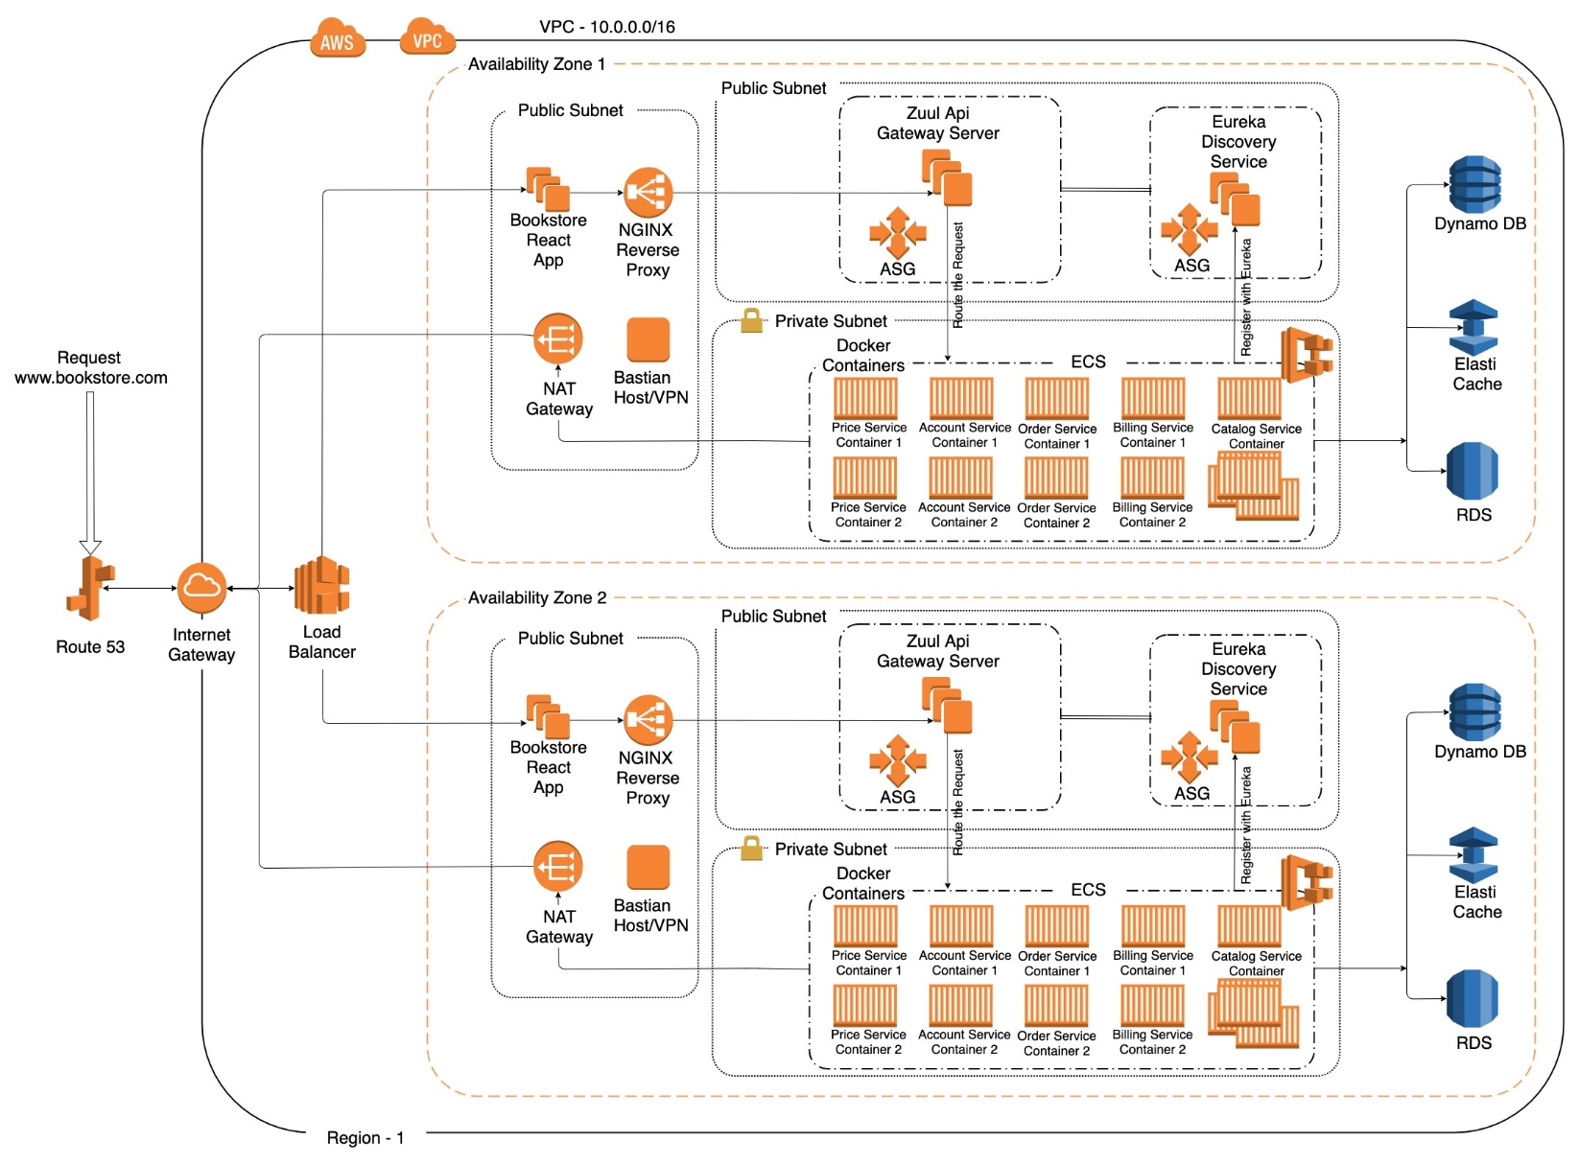
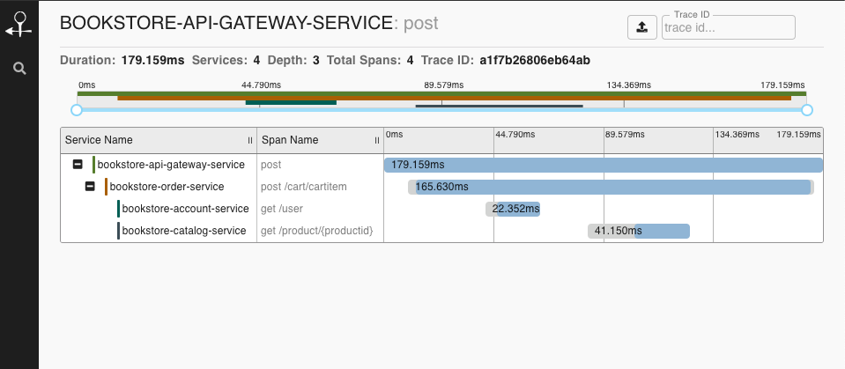
ARCHITECTURE

Slide 5
TEAM STRUCTURE AND RESPONSIBILTIES
Arnav Dasgupta
Debadrita Purkayastha
Developer: creating software programs, integrating systems and software, training end-users, analyzing algorithms, modifying source-code, writing system instructions, debugging, and maintaining operating systems
User experience designer:-Gathering use cases for the project and Responsibility for the product design to make it intuitive and user friendly
Rahul Dewan
Stuti Suthar
Developer: creating software programs, integrating systems and software, training end-users, analyzing algorithms, modifying source-code, writing system instructions, debugging, and maintaining operating systems
DevOps: To communicate effectively, improve visibility across the CI/CD pipeline and constantly learn new things.
Utkarsh Deshmukh
Quality Analyst:- responsible for developing and supporting the planning, design, and execution of test plans, test scripts, and process plans for projects
HOW FREQUENTLY DEPLOY ON PRODUCTION?
It is advised to adopt continuous deployment, if you're doing continuous delivery, you have the option of releasing as frequently as you like—every day, every month, or even every hour. But in our case, we deployed on a weekly basis. Keeping in mind the code quality.

Slide 6
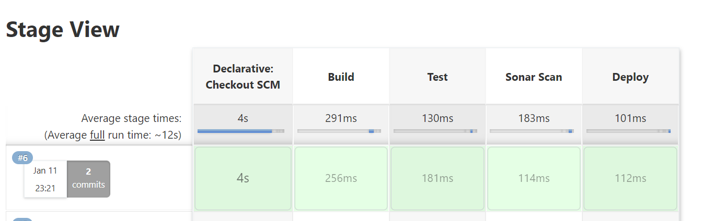
CYCLE TIME TO BUILD/ TEST/ DEPLOY.
AGILE PRACTICES PRACTICES FOLLOWED
Using an iterative framework, the Agile methodology relies upon the interaction of self-organizing teams of people who have the cross-functional skillsets required to develop tested, working software. The most commonly used programming practices – test-driven development, code refactoring, continuous integration, simple code design, pair programming, a common codebase and a single coding standard – contribute to the quality, flexibility and sustainability of the software.
Working software is the primary measure of progress.
Agile processes promote sustainable development. The sponsors, developers, and users should be able to maintain a constant pace indefinitely.
Continuous attention to technical excellence and good design enhances agility.
Simplicity – the art of maximizing the amount of work not done – is essential.
The best architectures, requirements, and designs emerge from self-organizing teams.
At regular intervals, the team reflects on how to become more effective, then tunes and adjusts its behavior accordingly.

Slide 7
DEVOPS PRACTICES FOLLOWED
DevOps practices reflect the idea of continuous improvement and automation. Many practices focus on one or more development cycle phases. These practices include:
Continuous development. This practice spans the planning and coding phases of the DevOps lifecycle. Version-control mechanisms might be involved.
Continuous testing. This practice incorporates automated, prescheduled, continued code tests as application code is being written or updated. Such tests can speed the delivery of code to production.
Continuous integration (CI). This practice brings configuration management (CM) tools together with other test and development tools to track how much of the code being developed is ready for production. It involves rapid feedback between testing and development to quickly identify and resolve code issues.
Continuous delivery. This practice automates the delivery of code changes, after testing, to a preproduction or staging environment. A staff member might then decide to promote such code changes into production.
Continuous deployment (CD). Similar to continuous delivery, this practice automates the release of new or changed code into production. A company doing continuous deployment might release code or feature changes several times per day. The use of container technologies, such as Docker and Kubernetes, can enable continuous deployment by helping to maintain consistency of the code across different deployment platforms and environments.
Continuous monitoring. This practice involves ongoing monitoring of both the code in operation and the underlying infrastructure that supports it. A feedback loop that reports on bugs or issues then makes its way back to development.
Infrastructure as code. This practice can be used during various DevOps phases to automate the provisioning of infrastructure required for a software release. Developers add infrastructure “code” from within their existing development tools.

Slide 8
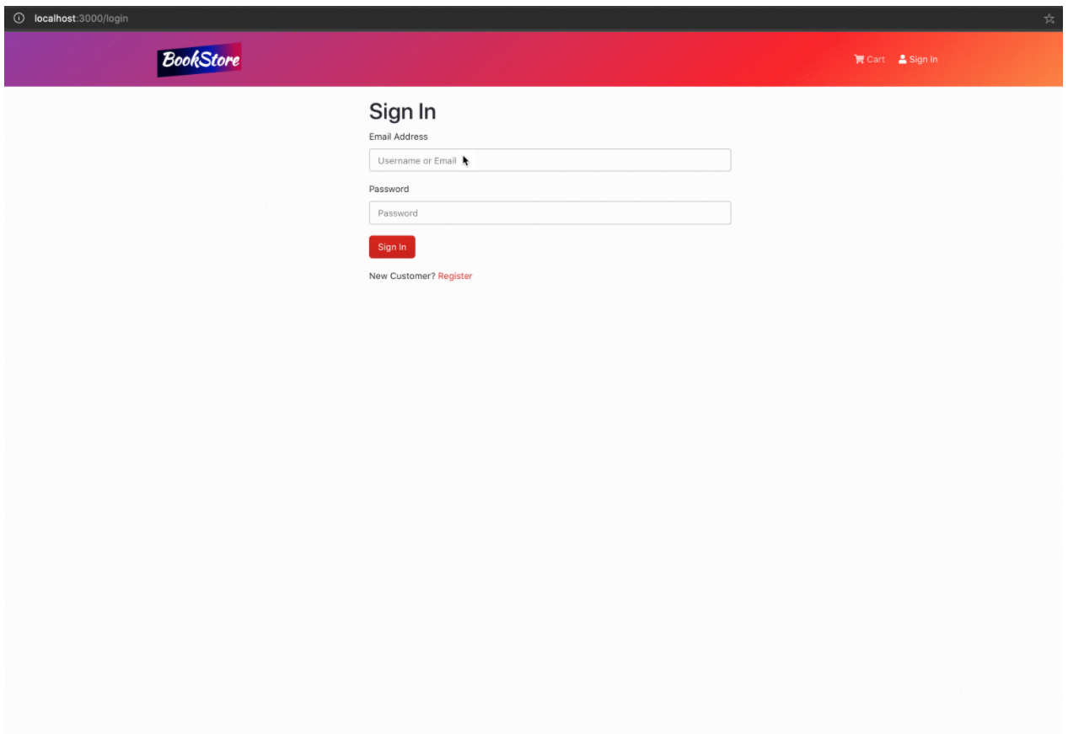
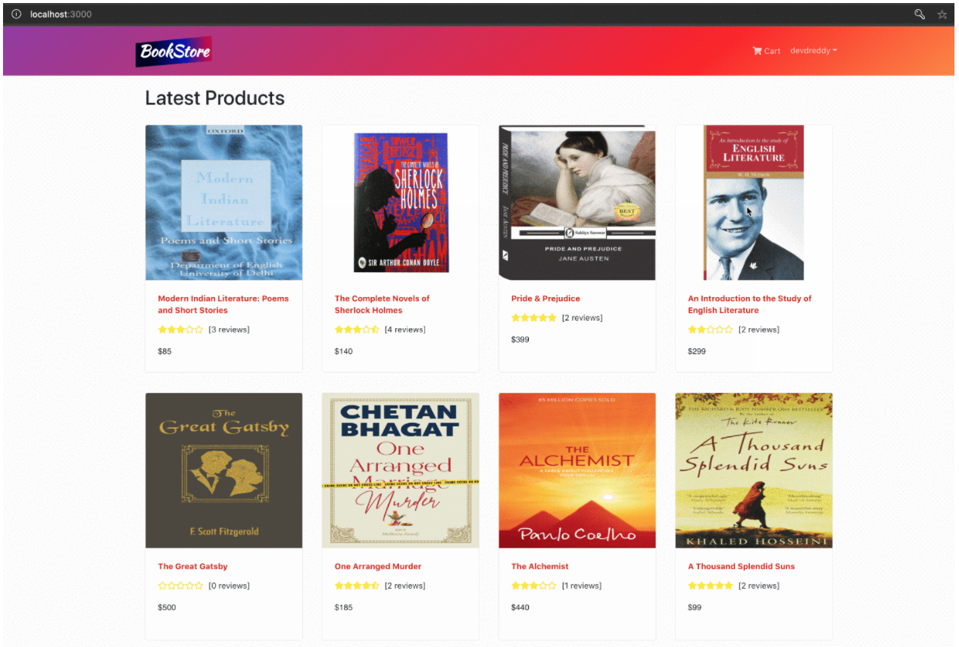
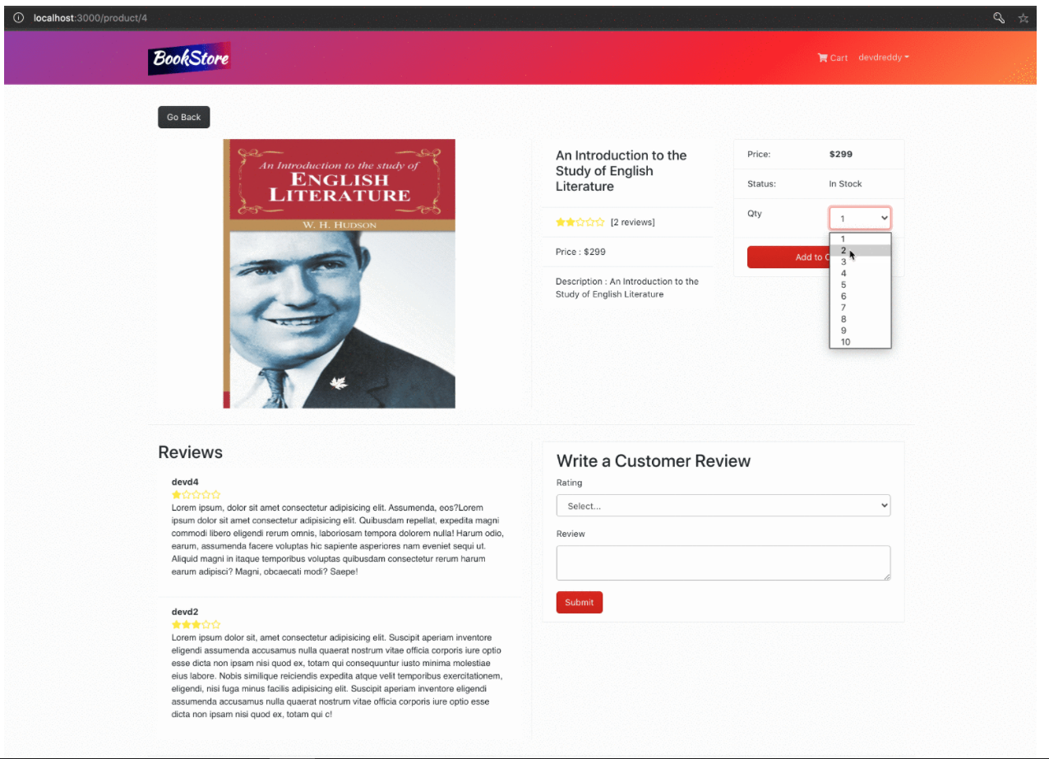
SCREENSHOTS
Micro service

Slide 9
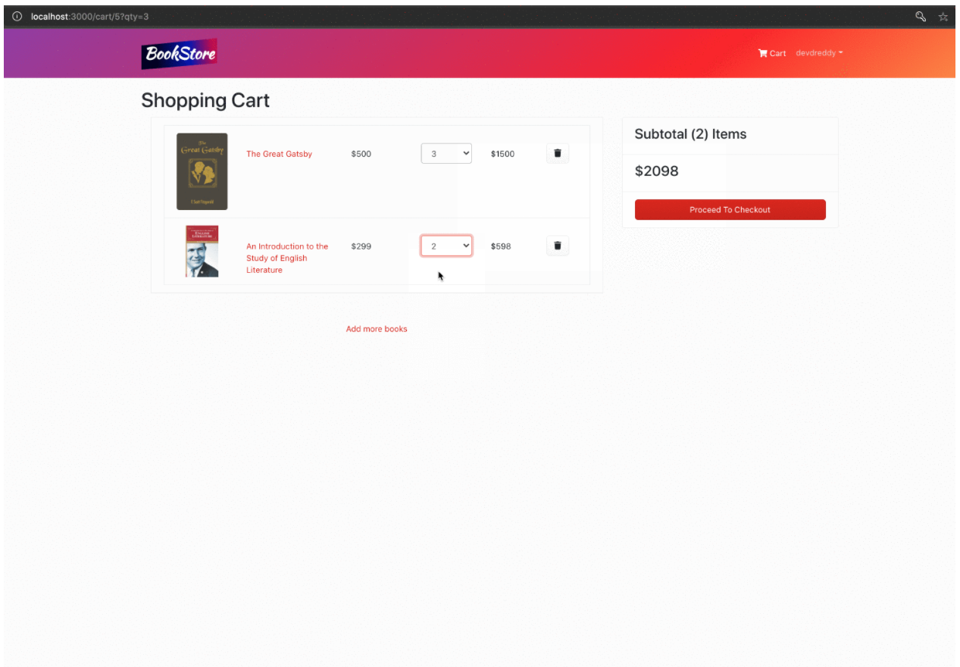
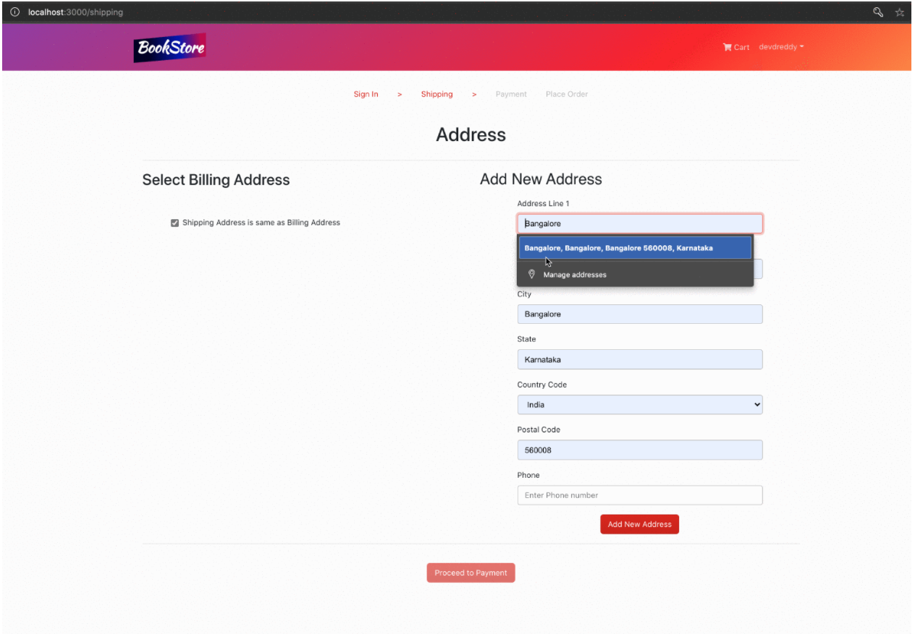
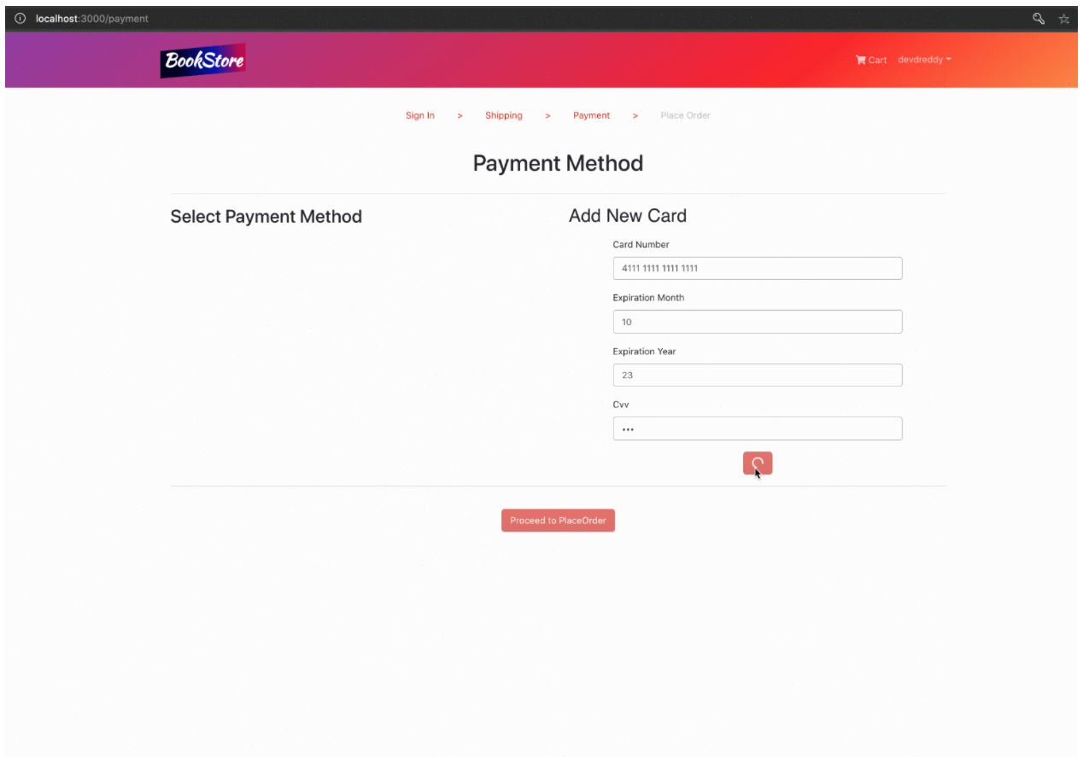
SCREENSHOTS
Micro service

Slide 10
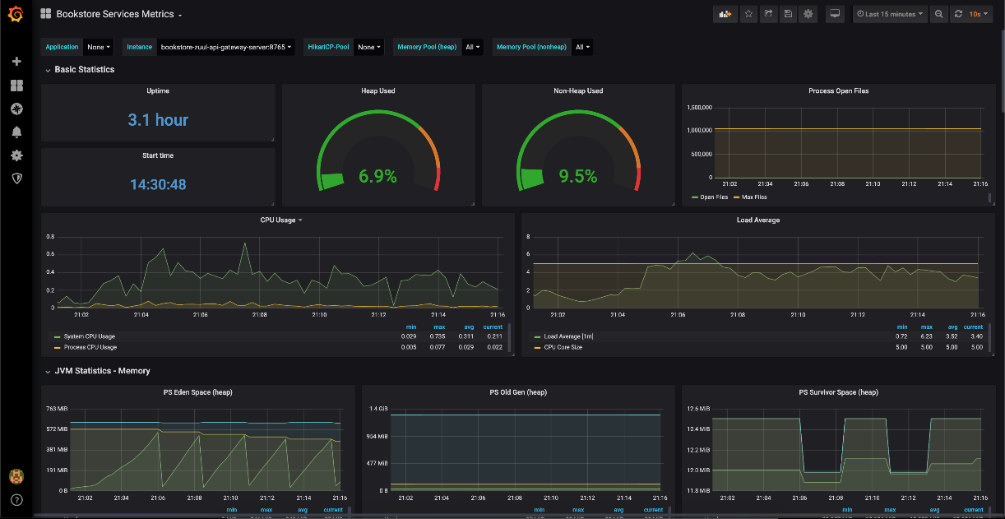
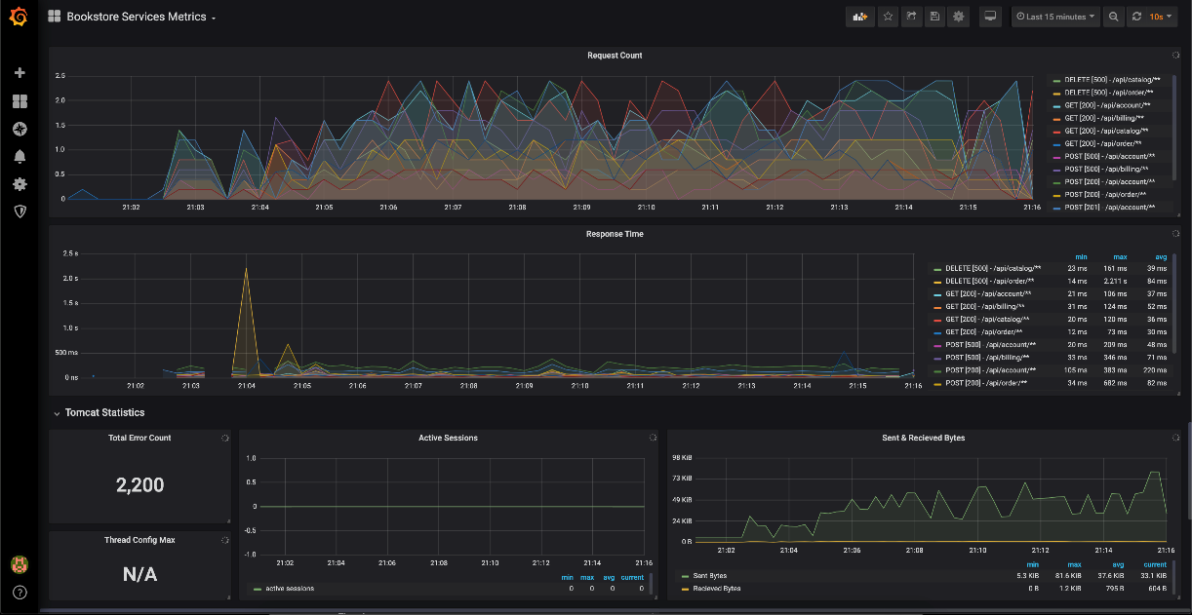
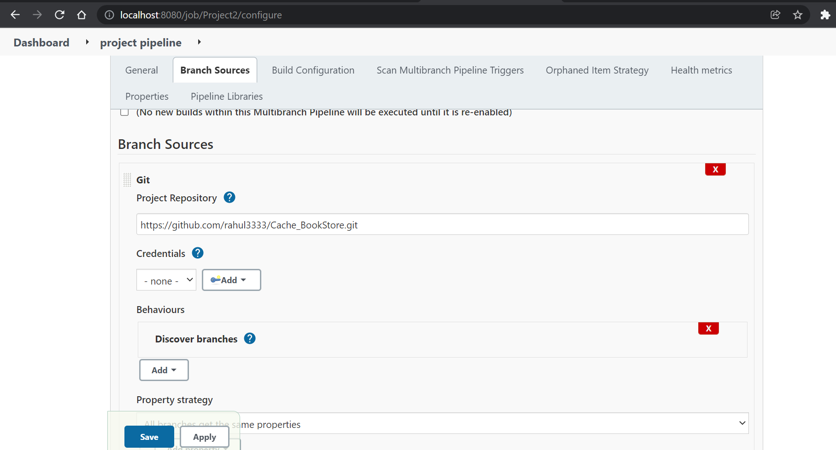
SCREENSHOTS
Graphana
Jenkins

Slide 11
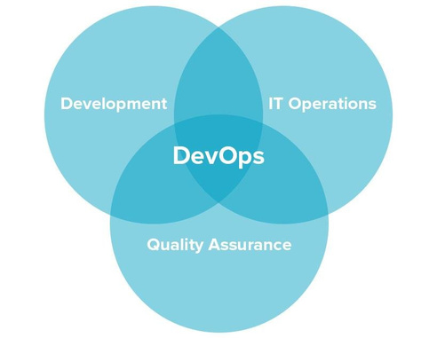
CURRENT ISSUES FACED
Faced difficulty during the installation of the tools in the local system.
Several codes were merged in the local branch and then pushed to the master which led to several inconsistencies in the existing project.
The versions of the software required for a smooth running of the project were not of the local system supported and lower versions of the same were installed in the project.
RECOMMENDATION
Today, DevOps is one of the most discussed software development approaches. It is applied in Facebook, Netflix, Amazon, Etsy, and many other industry-leading companies. So, if you are considering embracing DevOps for the sake of better performance, business success, and competitiveness, you take the first step and learn how DevOps work.
It’s a practice that aims at merging development, quality assurance, and operations (deployment and integration) into a single, continuous set of processes. This methodology is a natural extension of Agile and continuous delivery approaches.

Slide 12


